Slide 1
PHP & MYSQL
View PHP & MYSQL Course at: http://www.edureka.co/php-mysql
For Queries:
Post on Twitter @edurekaIN: #askEdureka
Post on Facebook /edurekaIN
For more details please contact us:
US : 1800 275 9730 (toll free)
INDIA : +91 88808 62004
Email Us : sales@edureka.co

Slide 2
Objectives
At the end of this module, you will be able to develop an attractive website with the excellent benefits such as smooth running, fast downloading, cost effective and easy to handle
In addition, you will be able to:
Understand the basics of PHP
Write and execute PHP scripts using Arrays, Strings and Conditional Logics
File handling manipulations
Describe Regular Expressions
Error handling and bugs debugging
Understand Object Oriented Programming language
Execute simple SQL commands using MySQL Client
Explains advanced query concepts like sorting and joins
Describe the major concept of SQL injection and prevention
Explains the import and export database

Slide 3
PHP & MySQL - Overview
PHP & MySQL is an open-source
PHP & MySQL are two key components in the open-source LAMP stack
It is the most appropriate tool for developing dynamic web pages. For example, we can develop informative forums, chatting platforms, e-commerce shopping carts, CRM solutions, community websites and database driven sites
PHP with MySQL is a powerful combination showing the real power of Server-Side scripting
PHP has a wide range of MySQL functions available with the help of a separate module

Slide 4
Benefits of PHP & MySQL
PHP web development means developing websites and dynamic web pages using the versatile and capable server-side scripting language
FREE OF COST
CAPABLE
PLATFORM INDEPENDENT
SUPPORTS ALL MAJOR WEB SERVERS
SUPPORTS ALL MAJOR DATABASES
SECURE
FASTER DEVELOPMENTS
LARGE COMMUNITIES
EASY
PROVEN AND TRUSTED

Slide 5
Intricacies of PHP & MySQL
Dynamic and Weak Typing
Variable Variables
Dynamic Arrays
Dynamic Constants
Dynamic Functions
Dynamic Code
Dynamic Includes
Built-in Functions
Superglobals
Notes:
REF: http://www.justlogin.com/leave-management-software/

Slide 6
PHP&MySQL – Website Creation
What can PHP&MySQL do while creating a website?
It can create custom content based on different variables
It is excellent in tracking user information
It can read or write information to databases
It can run on any type of platform and servers
It can do anything a standard HTML file can and much more

Slide 7

Example – Online Leave Application
Anyone who has applied for leave knows the frustration of leave form-filling and waiting as the hard copy travels up and down the approval hierarchy
The online leave management system with its powerful features, removes the physical movements and enables HR to have a clear view of the leave situation in the company, make decisive and on-the-spot approval decisions

Slide 8
Scenario
Consider that ABC Company handles online leave management system
This system will manage all the leave request, work from home request, add leaves and view all the leave request
In this system we have two types of users. They are
HR Administrator – Leave approver
Employee – Leave applicant
Both users have login credentials to login to the system

Slide 9
Roles of HR in Leave Management System
Roles of HR Administrator in Leave Management System
View all the leave request from all employees
View all the work from home request
Add leaves for particular year
Manage employee leaves
View the leave account of all the employees

Slide 10
Roles of Employee in Leave Management System
Roles of Employee in Leave Management System
Apply for the leave
Request for Work from home
View the leave requested so far
View the Leave history

Slide 11
Working Process
Here, we will see the below steps:
How the employee will apply leave in online
The leave will be notified to the HR through email
Leave approved by HR administrator
To apply and approve for leave both the users should have the credentials to login to the system
Credentials:
Username
Password
We need to have two tables, one is Employee_Details and another is Leave_Details
Employee_Details table is used to store credentials and details of the user
Leave_Details table will store the leave history of the user

Slide 12
Working Process
Employee_Details Table
Field Name | Description
Employee Code | Unique key to identify employee
Name | Name of the employee
Designation | Designation of the employee
Contact Number | Contact number of the employee
Email id | Email id of the employee
Username | Username to login to the system
Password | Password
Field Name | Description

Slide 13
Working Process
Leave_Details Table
Field Name | Description
ID | Employee Code
Employee Code | Unique key to identify employee
Leave Type | Type of the leave. It will be casual, sick etc.
Duration | Full day or Half day
Leave From | From date of the leave
Leave To | Leave ending date
Reason | Reason for leave
Status | Approve or Declined

Slide 14
How?
?
Do you know, how to submit the leave application online?

Slide 15
PHP - Script
Develop a script in which the employees can easily app for leave through online and HR can approve in online
Step1: Create tables
Step2: Create Login form to login to the system
Step3: Create leave application form
Step4: Store leave details in database
Step5: Notify leave request through mail
Step6: Approves leave
Step7: Notify leave status to customer

Slide 16
Creating a Leave Application Form
Create Leave form
The leave form will contains the following fields
Field 1: Leave Type
Select the leave type. The types will be casual, sick and earned etc.
Field 2: Duration
Duration of the leave. Either Full day or half day
Field 3: Leave From
Specify the from date
Field 4: Leave To
Specify the to date. If the leave is for half day then there is no need to specify to date
Field 5: Reason
Specify the Reason for the leave
Create Submit button to submit the values

Slide 17
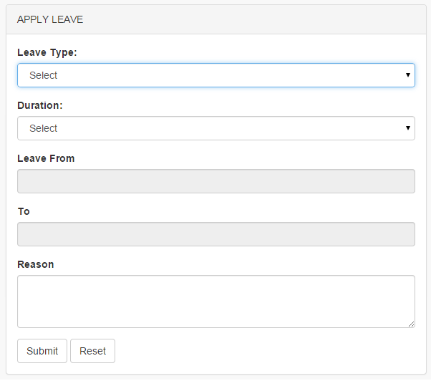
Creating a Leave Application Form (Contd.)
Leave Form
Step 1: Code to create drop down box to select leave type
<select name="leave_type" id="leave_type"> <option value="0">Select</option>
<option value="casual_leave">Casual Leave</option>
<option value="sick_leave">Sick Leave</option>
<option value="earned_leave">Earned Leave</option>
</select>
Step 2: Follow step1 to create drop down for duration field

Slide 18
Creating a Leave Application Form (Contd.)
Leave Form
Step 3: Code to create text box to get ‘leave from‘ from user
<input name="from" id="from" type="text”>
Step 4: Follow step 3 to create another text box to get ‘to’ field
Step 5: Code to create text area
<textarea name="reason" id="reason" type="text“ rows='3'/></textarea>
Step 6: Code to create submit and reset button
<input name="submit" type="button“ id="button" value=" Submit “ />
<input type="reset" name="reset" value="Reset“ />

Slide 19
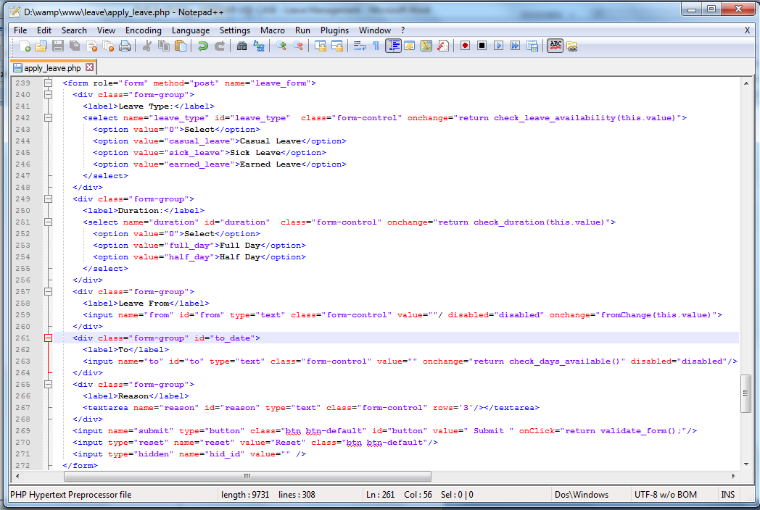
Script to Create Leave Application Form

Slide 20
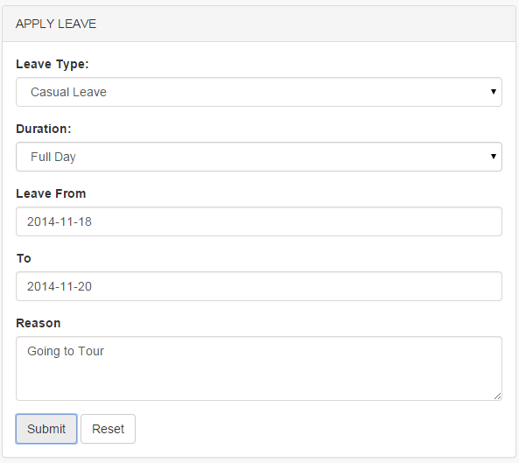
Leave Request
Enter the leave details and click submit button to request for leave
The submit button will perform two actions:
Store the leave request in Leave_details form
Notify the concerned person through mail to approve for leave

Slide 21
Store Leave Request
Step 1: Create database
Using create database command create database
Step2: Create Table
Using create table command create table
Step3: Establish connection to the database
Using mysql_connect() function establish the connection
Step4: Insert into database
Using insert query we can insert the values into table

Slide 22
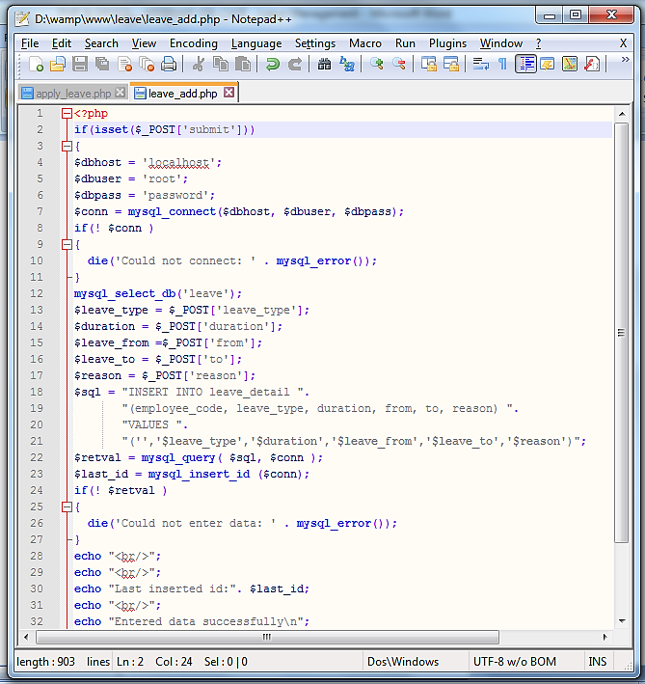
Script to Store Leave Request

Slide 23
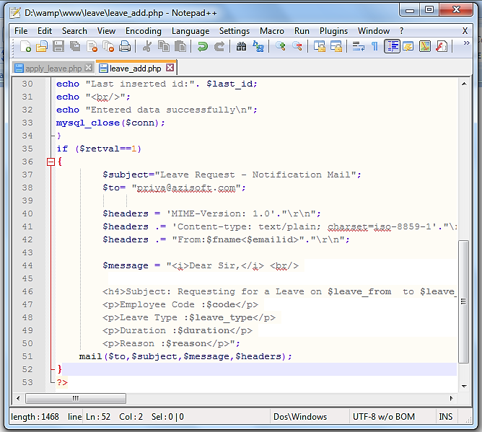
Script to Notify Leave via email

Slide 24
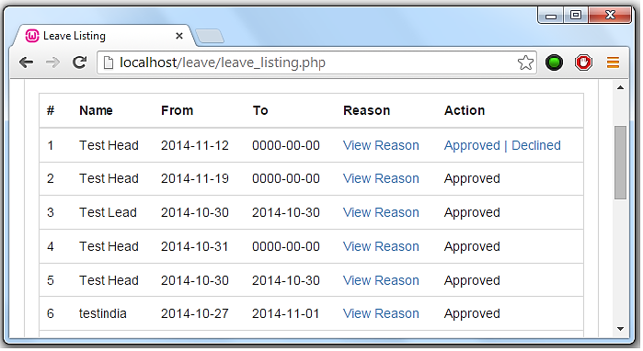
Approves Leave Request
Step 1: To approve leave request login as a HR
Step2: View the list of leave request by the employees
Step3: Approve or Decline the leave
Step4: Notify the status of the leave to employees through mail

Slide 26
Course Topics
Module 1
PHP Basics and Conditional Logic
Module 2
Forms
Module 3
Functions & Error Handling
Module 4
Object Oriented Concepts
Module 5
MySQL Introduction and MySQL Basics
Module 6
Data Manipulation
Module 7
Advanced Queries & SQL Injection
Module 8
Backup & Recovery Methods
Module 9
Project- 1
Module 10
Project- 2

Slide 27
How it Works?

